Slide 1

Dimensionality Reduction
Simplifying life
Yordan Darakchiev
Technical Trainer
iordan93@gmail.com

Slide 2
sli.do #MachineLearning

Slide 3
Table of Contents
Projections and dimensionality reduction
Problem definition
PCA
Kernel PCA
LinDA
Manifold learning
Problem definition
Isometric mapping
t-SNE
Real-world examples

Slide 4
Dimensionality Reduction
Reducing the number of features via projection

Slide 5
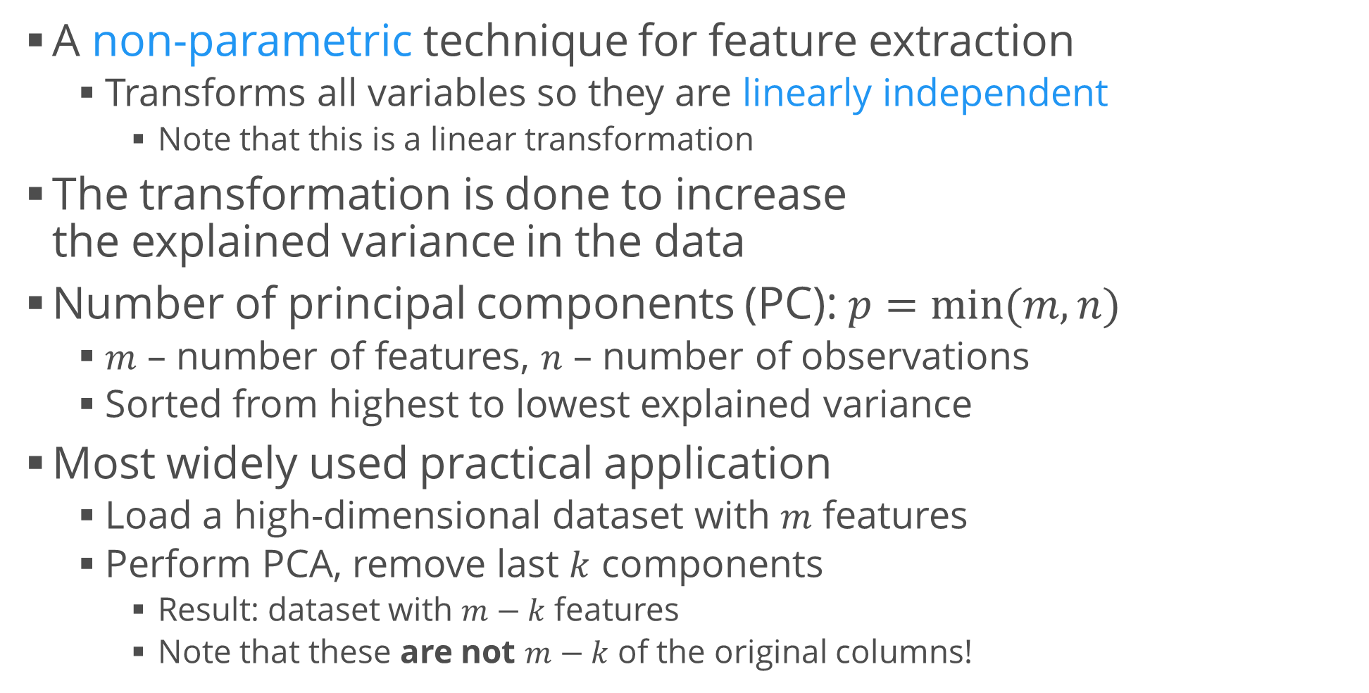
Principal Component Analysis (PCA)
A non-parametric technique for feature extraction
Transforms all variables so they are linearly independent
Note that this is a linear transformation
The transformation is done to increase the explained variance in the data
Number of principal components (PC): $p=min⁡(m, n)$
$m$ – number of features, $n$ – number of observations
Sorted from highest to lowest explained variance
Most widely used practical application
Load a high-dimensional dataset with $m$ features
Perform PCA, remove last $k$ components
Result: dataset with $m−k$ features
Note that these are not $m−k$ of the original columns!

Slide 6
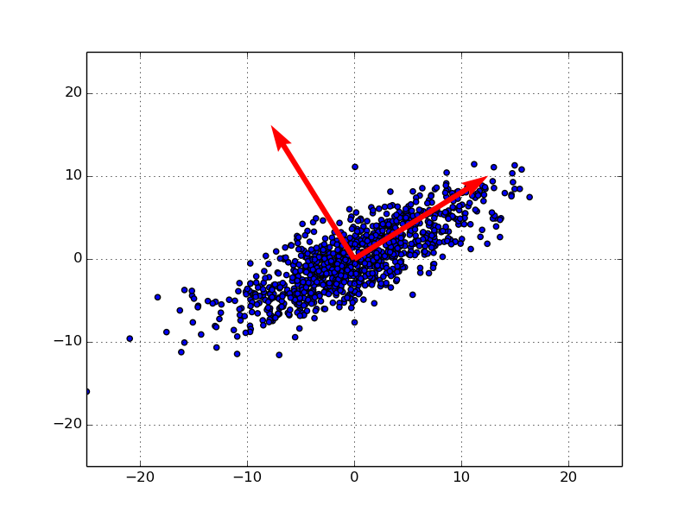
PCA Intuition
There is a lot of math (and even physics) involved
Intuitive explanation: casting a shadow
Projection into a lower-dimensional space
A nice visualization of PCA
Example: 2D
The first principal component aligns with the axis of most variance in the data
The second is perpendicular to the first
All components are mutually orthogonal
I.e. linearly independent
Result: The red arrows represent a new coordinate system
Also: if we drop the second coordinate, we've achieved dimensionality reduction without too much loss of information

Slide 7
Example: PCA in scikit-learn
Reproduce the 2D example
Generate a blob
Use a shear transformation to make it look like a rotated ellipse
You can look up how to do this, for example in Wikipedia
Plot the original data, after the transformation
Rescale the data
This is really important in PCA, otherwise columns with large values will dominate in the PCs
Fit a PCA and apply the learned transformation to the original data
Plot the transformed data
Plot the explained variance ratios of the various components
from sklearn.decomposition import PCA
pca = PCA().fit(data)
transformed_data = pca.transform(data)

Slide 8
Kernel PCA
As we saw, PCA only works for linear transformations
We can obtain non-linear transformations using the "kernel trick"
Exactly the same way as we did in SVMs
This allows us to separate non-convex and non-linear data
Such as nested circles
As before, we need to set the gamma parameter
Width of the kernel (in the case of rbf)
If we don't know the exact value, we need to perform grid search
Docs (note how linear PCA doesn't separate the data)
Usage
from sklearn.decomposition import KernelPCA
pca = KernelPCA(kernel = "rbf", gamma = 5).fit(data)
transformed_data = pca.transform(data)

Slide 9
Linear Discriminant Analysis (LDA)
LinDA is a supervised method which tries to identify the attributes that account for the most variance between classes
Used in classification cases, with known class labels
Returns a transformation of the input data, similar to PCA
Comparison of 2-component PCA and LinDA on the Iris dataset
Linear Discriminant Analysis and Latent Dirichlet Allocation have the same acronyms, and are both used for dimensionality reduction / transformation
They work in completely different ways
from sklearn.discriminant_analysis import LinearDiscriminantAnalysis
lda = LinearDiscriminantAnalysis(n_components = 2)
transformed_attributes = lda.fit(attributes, labels).transform(attributes)

Slide 10
Manifold Learning
"Flattening out" surfaces in fewer dimensions

Slide 11
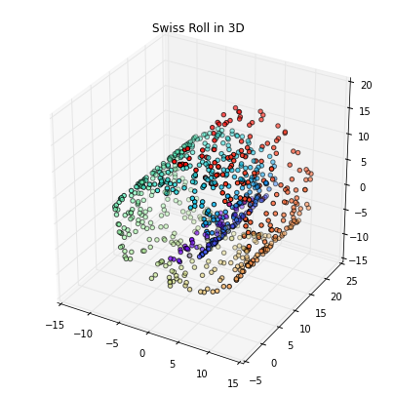
Problem Definition
Manifold = surface / shape (not necessarily a plane)
Idea
The dimensions are only artificially high
Even though there are many features, they can be expressed with a few parameters
"Low-dimensional manifold in a high-dimensional space"
Non-linear methods
Example: "swiss roll" dataset
2D "curled" shape in 3D
Used not only for dimensionality reduction, it's a common way to visualize high-dimensional datasets
Especially for classification cases

Slide 12
Isometric Mapping
Seeks a lower-dimensional projection (embedding) which preserves distances between points
Algorithm overview
Find the k nearest neighbors of each point (kNN)
Construct a connectivity graph
Two points are connected if they're neighbors (from the first step)
Compute shortest paths (Dijkstra, Floyd-Warshall)
Perform projection on the graph
Similar to PCA
High-level overview: project a manifold using nearest neighbors
from sklearn.manifold import Isomap
isomap = Isomap(n_neighbors = 5, n_components = 2)
transformed_data = isomap.fit_transform(data)

Slide 13
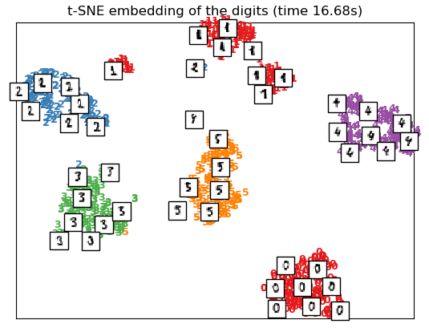
t-SNE
t-distributed Stochastic Neighbor Embedding
Isomap tries to "unfold" a continuous structure
This is also true for other algorithms (comparison)
t-SNE looks for local clusters in the data
Useful for revealing clusters and structure
Usual implementation: Barnes – Hut (2D or 3D only)
To preserve high-dimensional structure, we need to initialize it with PCA (instead of randomly)
It can be slow
Mainly used for visualization in image and text processing
from sklearn.manifold import TSNE
tsne = TSNE(n_components = 2, init = "pca")
transformed_data = tsne.fit_transform(data)

Slide 14
Real-World Examples
Seeing dimensionality reduction in action

Slide 15
Example: Iris dataset
Perform PCA on the Iris dataset
Use the results to perform feature selection
Compare the results to isometric mapping and 2D t-SNE
Visualize the first 2 components in all three cases
Choose a classifier and score it before / after PCA
E.g. random forest
In most cases, first components will give a lower score but the algorithm will perform much faster (fewer variables)
Don't forget to transform new incoming data!
You can use pipelines to do this
Compare kNN results on the raw dataset, and on the isomap transformation

Slide 16
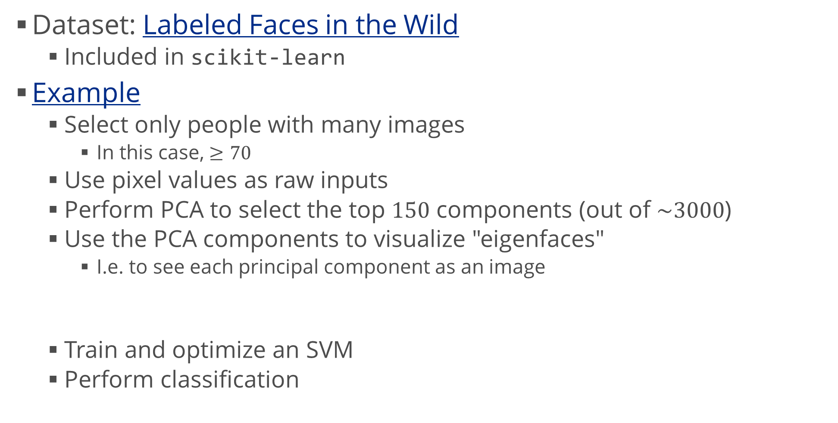
Example: Eigenfaces
Dataset: Labeled Faces in the Wild
Included in scikit-learn
Example
Select only people with many images
In this case, $≥70$
Use pixel values as raw inputs
Perform PCA to select the top $150$ components (out of $\sim 3000$)
Use the PCA components to visualize "eigenfaces"
I.e. to see each principal component as an image
Train and optimize an SVM
Perform classification
eigenfaces = pca.components_.reshape((n_components, h, w))
# h, w are image height and width

Slide 17
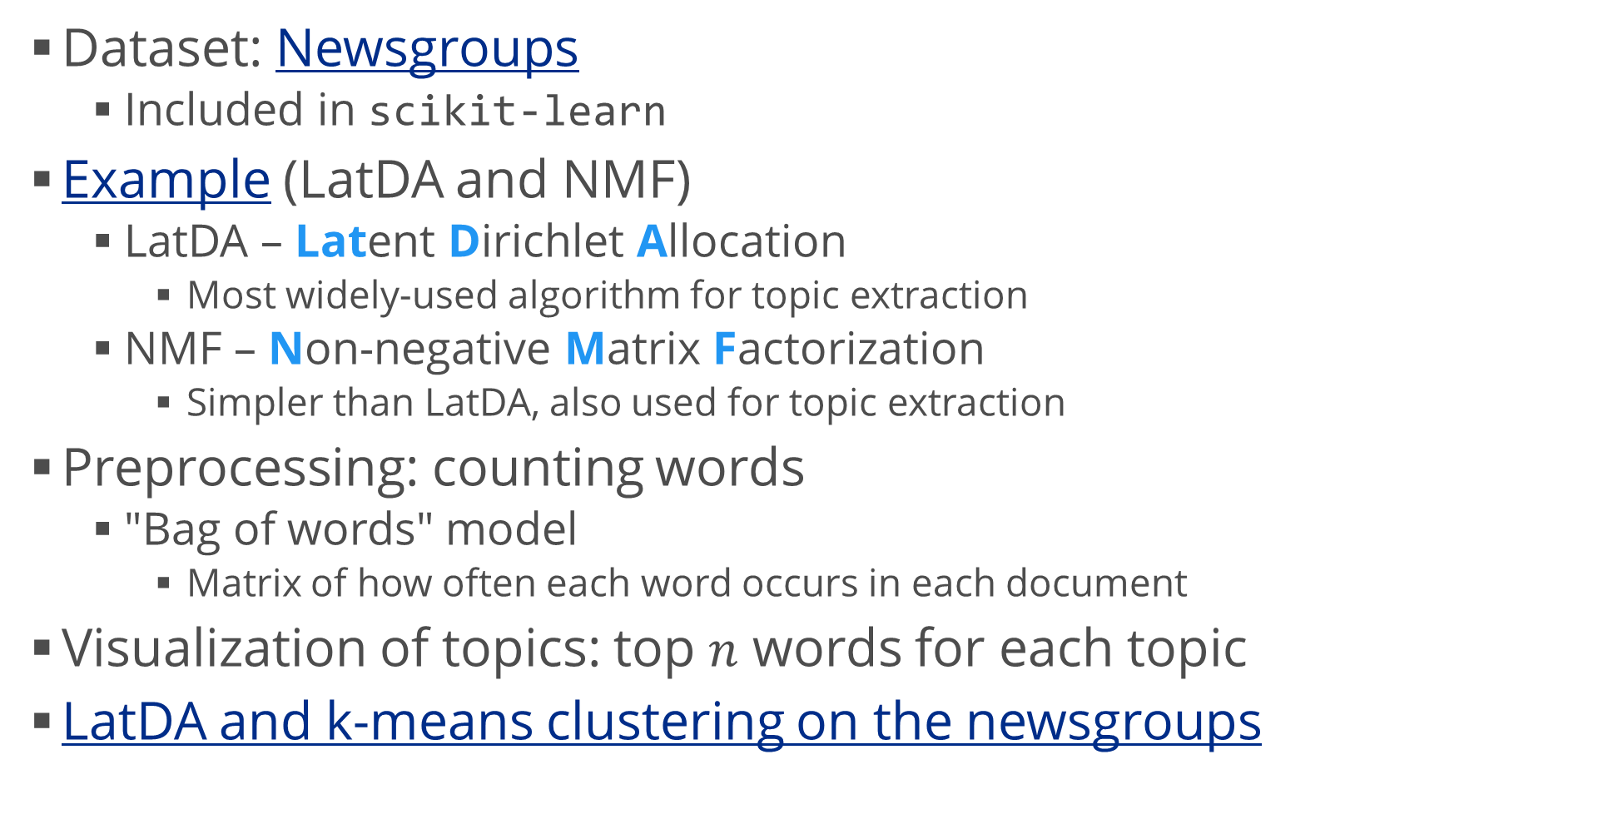
Example: Topics in Text
Dataset: Newsgroups
Included in scikit-learn
Example (LatDA and NMF)
LatDA – Latent Dirichlet Allocation
Most widely-used algorithm for topic extraction
NMF – Non-negative Matrix Factorization
Simpler than LatDA, also used for topic extraction
Preprocessing: counting words
"Bag of words" model
Matrix of how often each word occurs in each document
Visualization of topics: top $n$ words for each topic
LatDA and k-means clustering on the newsgroups

Slide 18
Summary
Projections and dimensionality reduction
Problem definition
PCA
Kernel PCA
LinDA
Manifold learning
Problem definition
Isometric mapping
t-SNE
Real-world examples

